Slide 1
Git hub commands
15 basic commands with explanation

Slide 2
Command 1 and 2:

Slide 3
Command 3 and 4:

Slide 4
Command 5 and 6:

Slide 5
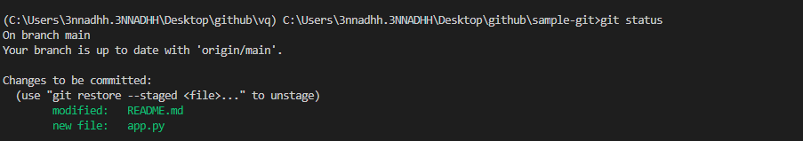
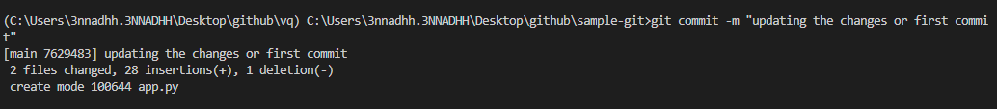
Command 7 and 8:

Slide 6
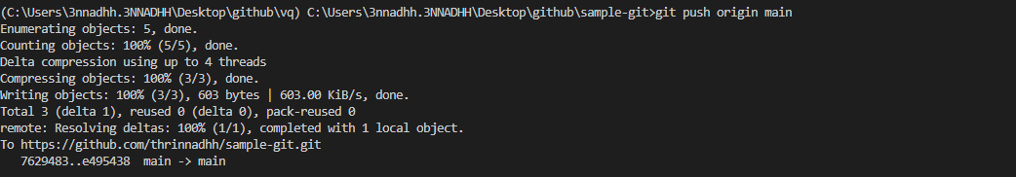
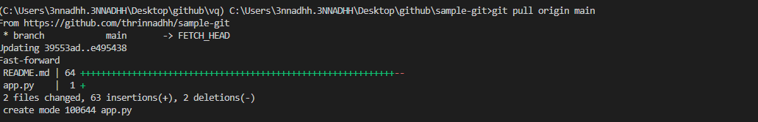
Command 9 and 10:

Slide 7
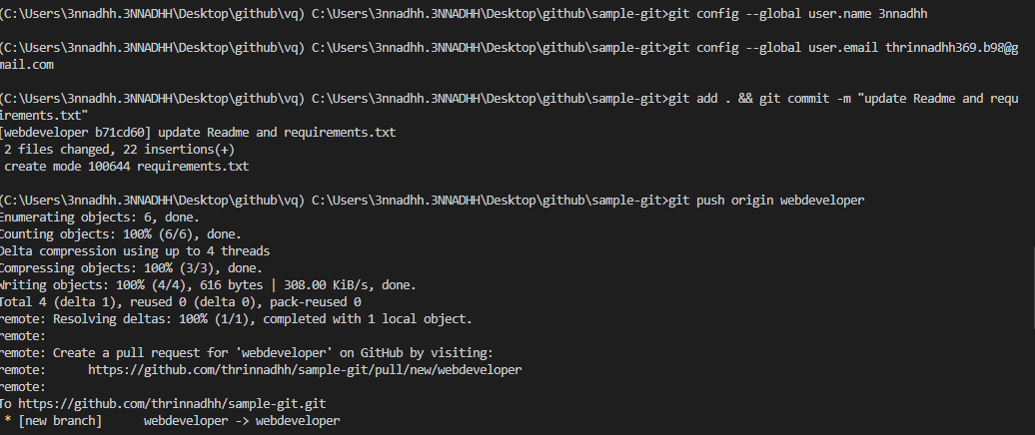
Command 11:

Slide 8
Command 12 and 13:

Slide 9
Command 14:

Slide 10
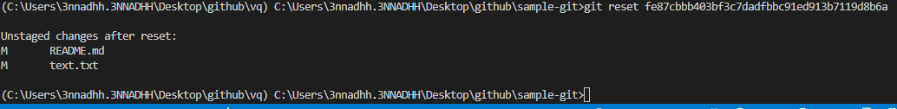
Command 15:

